Slide 1
Arts Expedition
WEBINAR FIVE
Awareness Education
Experience Advocacy

Slide 2
Funding support provided by the

Slide 3
A Guide to Career Development Opportunities for Visual and Performing Artists with Disabilities
from

Slide 4
WEBINAR FIVE
Advocacy

Slide 5
This final webinar begins with a story about two remarkable artists who creatively adapted their work in the arts to meet their own special needs.

Slide 6
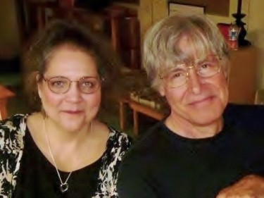
Carol Ponder and Robert Kiefer have been performing arts professionals for over 40 years, working as a creative team on a wide variety of projects.

Slide 7
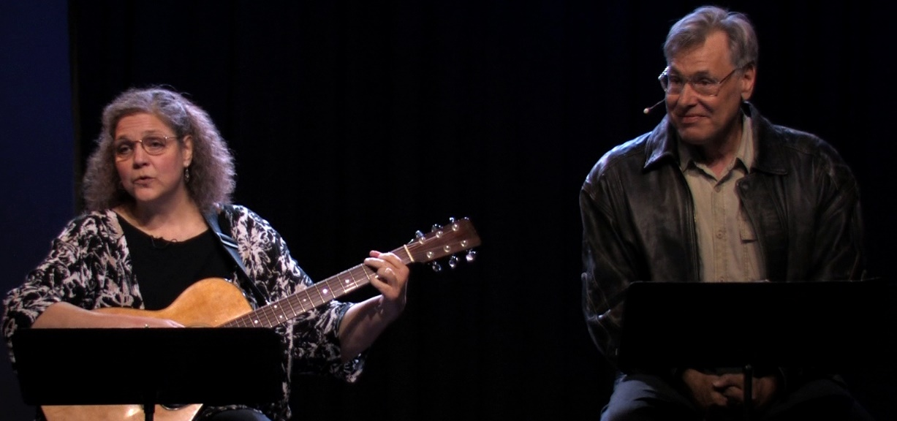
The married couple is now touring with a theatre piece they crafted to accommodate both their abilities and disabilities. Inspired by response to their performance at a VSA Tennessee event on Veterans Day, they created Ponder Anew: A WWII Warrior’s Story, adapted from a memoir written by Carol’s father, himself an accomplished storyteller. Laced with songs from the WWII period and traditional Appalachian music, the inspirational show has received significant critical and audience response.

Slide 8
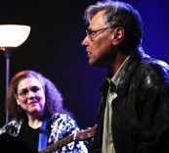
Carol
Carol is a storyteller, actress and award-winning singer of Americana with a specialty in a cappella ballad. She plays guitar, autoharp, and spoons and has appeared on the Kennedy Center Millennium Stage as well as at dozens of arts centers, schools, and clubs in the United States and in Northern Ireland. She also works as a teaching artist, consultant, and project facilitator in education through the arts.

Slide 9
ROBERT
Robert is a theatre director and actor with a specialty in developing one-person shows, whose work has been seen at the Piccolo Spoleto Festival in Charleston, in colleges and universities, and in arts centers around the country. His most recent work, Harriet Beecher Stowe: A Literary Soldier, was performed at the celebration of the author’s 200th birthday. Robert also teaches public speaking to clients from all walks of life and directs and produces Carol’s music, concerts, and recordings.

Slide 10
Let’s hear the story about how they created Ponder Anew: A WWII Warrior’s Story to accommodate their special needs.

Slide 11
Carol: I have been affected by osteoarthritis since I was quite young. I had my first knee repair surgery at age 35. Now, at age 60, I have two replaced knees, a replaced hip, a rebuilt foot, and ongoing severe spinal and other arthritis. The most difficult of my personal mobility issues have become the unrelenting pain of significant fibromyalgia and chronic fatigue syndrome, which frequently occur together. My dear husband, Robert, has had several arthritis-related surgeries, including a knee replacement, and has had three cancer events since 2003, all of them involving major surgery, one with systemic radiation. Needless to say, we are not as spry as we once were! We do have bad days, but we keep moving, depending on our support for each other and inspired by our passion for performing and teaching.

Slide 12
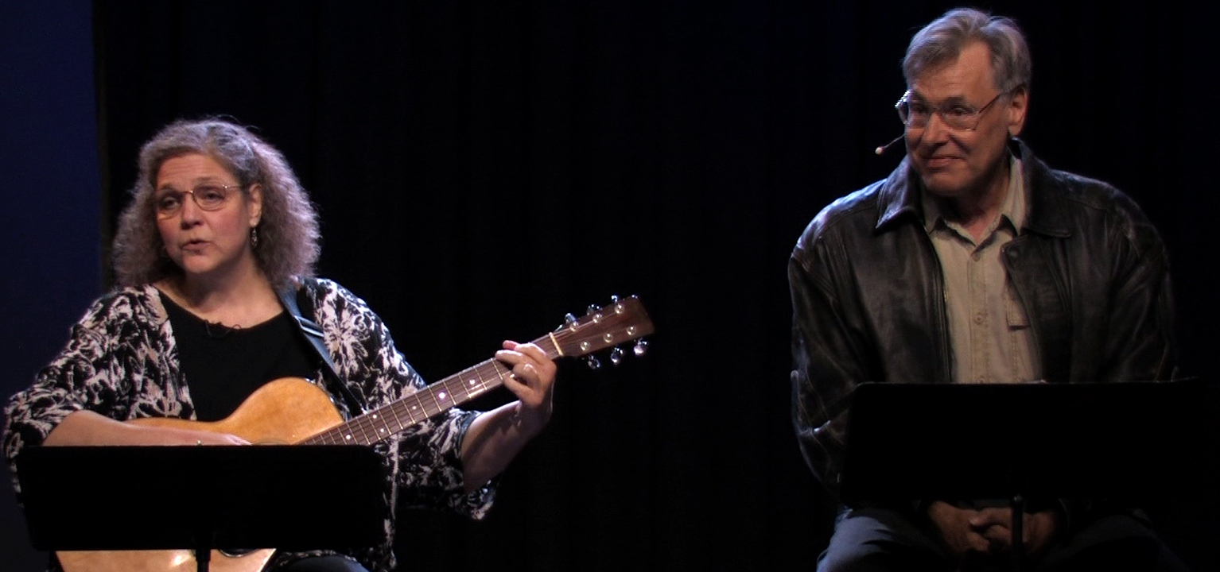
Carol: When we read excerpts from Dad’s memoir for the VSA event on Veterans Day, mixed with a few songs, the response was overwhelming. We knew then that his memoir would work as readers’ theatre. We crafted the full piece so that Robert and I could simply sit on stools with our scripts on music stands in front of us, with me holding my guitar.

Slide 13
Robert: In readers’ theatre, your voice is your primary instrument, but you are using the rest of your actor tools – body language, facial expressions, character development – just as intensely as in any theatrical form, EXCEPT we never have to move from our stools. Audiences create the images of the story in their minds. This is a truly ‘cinematic’ experience, much more effective than any series of slides or images as background or attempts to act out the story would be. The song - some traditional and some from the World War II period - evoke the times and places in the story and heighten the emotional impact.

Slide 14
Carol: Our physical limitations dictated the form of Ponder Anew, but we soon realized that this was a staging that was the best way to honor my father’s storytelling voice by keeping the focus on his words. His memories are literally an open book in front of us. Audiences of all ages – veterans, their families, and civilians, and from all walks of life – have a powerful, moving experience every time we perform.

Slide 15
What has inspired and encouraged you as you’ve faced significant health challenges in recent years?
Robert: The unswerving support of my wife and the prospect of being able to direct another play. I’m inspired to keep my game sharp by the new crop of actors, playwrights and directors who are coming along.
Carol: First and always, my partner in life, love, and art, Robert, inspires me every day. Incredibly, he continues to work and play as hard as he can, in spite of the cancers. We’re tied together to each other and our world through a deep spirituality expressed so clearly through our art. We will continue to perform and teach for as long as we can. Knowing that we have this good work to do keeps me moving, no matter what.

Slide 16
For more information, see www.carolandrobert.com

Slide 17
The focus of this webinar is advocacy and access
Carol and Robert’s story emphasizes the creativity, passion, and ingenuity of artists just like you. They adapted their work to meet their own unique needs, serving as their own advocates to create a performance piece that works for them. They were not afraid to try something new and different. In addition, Carol and Robert illustrate the importance of giving and receiving support from other people who might be spouses, family members or friends.

Slide 18
At the end of this webinar, you’ll hear about Overton High School in Memphis, Tennessee for some inspiring words about the commitment to including students with disabilities as a school for the arts.
For now …. Imagine all of the opportunities and services that a visual or performing arts facility could offer.

Slide 19
Enjoying art is important to the life of any artist to find inspiration, feed your soul, expand your vision and just have fun. Do you have access to all of the opportunities of interest to you? If not, contact the organization to inquire about the addition of services that will include you in the programs of interest to you. You can do this on your own or working with a grassroots organization for people with disabilities. It starts with a phone call or an email.

Slide 20
The Tennessee Performing Arts Center in Nashville, for instance, received inquiries from The Middle Tennessee Council of the Blind and the Hearing Loss Association of America—Nashville chapter about providing audio description and open captioning. After lengthy dialogue with these groups, internal discussions, and considerable research, the arts center launched both of these services in recent years. (American Sign Language was already provided). TPAC offers all three services at the Sunday matinee of the shows in its Broadway season ticket series, in addition to other accommodations for people with disabilities.

Slide 21
Most organizations across Tennessee include accessibility information on their web sites. Start there or place a telephone call to ask for information.

Slide 22
Accessibility is a top priority for the Tennessee Arts Commission (TAC), which now requires the name of the access coordinator within any organization applying for a grant. The TAC has actively worked with program directors and facility managers across the state to define and promote the services they offer. If you have any questions about accessibility for people with disabilities at arts organizations, contact William Coleman, CDE, Director of Arts Access at the TAC at 615-532-9797 or william.coleman@tn.gov.

Slide 23
Another resource is the United States Department of Justice, which has a hotline for questions and concerns about accessibility requirements of the Americans with Disabilities Act:
www.ada.gov or call 800-514-0301

Slide 24
Here’s one final example that serves as a model for the inclusion of people with disabilities in the arts:
Overton High School
Shelby County’s Premier Optional High School
for the Creative and Performing Arts
Memphis, Tennessee
www.overtonhs.net

Slide 25
Overton High School
Overton High School principal Brett Lawson is making it a priority to ensure that young people with disabilities have full access to arts education, tapping into VSA Tennessee programs and services, including training from teaching artists.
“In our focus as a stand-alone school of the arts, we don’t want to exclude any student. All young people should be exposed to deep curriculum connected to the arts,” said Lawson.

Slide 26
Overton High School
Assistant principal Gregory Billings is the administrator for creative and performing arts and university academies at the school, which is currently studying the possibility of changing its current school structure from a "school within a school" design to a freestanding school for the arts. The new design would include its original Optional School for the Creative and Performing Arts and add the Very Special Arts (VSA) and the Arts Industry (a vocational educational experience supporting careers in the arts).

Slide 27
Overton High School
Identified in 2014 as a VSA Tennessee-sanctioned school, many students with disabilities are already participating in the fine arts and VSA programs at Overton High through dance, visual arts, and music. Overton VSA students include students with Down's syndrome, blindness/visual impairments, gifted and talented diagnoses, and with other special needs and/or impairments. Overton High School has the only resource placement for high school students with blindness/visual impairments in Shelby County Schools.

Slide 28
Overton High School
Lawson, Billings and assistant principal Michael Sizemore all had teaching experience in the arts before they became administrators. Their commitment is inspiring: They believe that they make a difference in the school community and the individual lives.

Slide 29
Overton High School
“The arts are vital to working with exceptional children, helping them to become a more complete citizen, a more complete human being,” said Lawson, who spoke to his previous experience at Kingsberry Elementary School. “We took everyone in the school to five live performances and had teaching artists at the school before and after that. We made the most of it and we saw indicators like vocabulary rise on standard tests. We know it works. We’ve seen it work,” he said.

Slide 30
Nationwide, numerous studies indicate that participation in the arts is linked to higher academic achievement, standardized test scores (including IQ), graduation rates, and much more, in addition to positive social and civic outcomes. For an excellent overview of research, including results for children with disabilities, see
ArtsEdSearch.org

Slide 31
As artists, you are among the best advocates for the importance of accessible arts education for young people.
In closing, please remember to complete the survey at the end of this final webinar to receive your certificate of completion and add that to your résumé!
Please fill out the brief questionnaire by clicking the link below or paste the url in your browser
http://iren.es/artsexp5

Slide 32
VSA Tennessee and the Tennessee Arts Commission wish you success in your artistic pursuits and thank you for your creative contributions to your community and your state.
Dream on!

