Slide 1
Arts Expedition
WEBINAR TWO
Awareness Education
Experience Advocacy

Slide 2
Funding support provided by the

Slide 3
A Guide to Career Development Opportunities for Visual and Performing Artists with Disabilities
from

Slide 4
WEBINAR TWO
Exploring
Career Possibilities

Slide 5
The rich artistic and cultural heritage of Tennessee is truly a great treasure and a source of pride for its citizens. The traditions continue through your work as an artist. History is in the making because YOU are creating art today. YOU are contributing to the future of the vitality of the arts in the state.

Slide 6
From Tennessee’s largest cities to its rural communities, an impressive number of artists are at work. They perform across the state and exhibit work at galleries. They take part in festivals. They teach. They create art in their studios.

Slide 7
The last U.S. Census documented about 35,000 people who make their living here as artists. Many more are arts educators and people who pursue artistic expression in addition to their employment with non-profit organizations, businesses, corporations, and educational institutions.

Slide 8
One way to celebrate the arts and artists flourishing in Tennessee is to take a look at an alphabetical list of individuals who received the Governor’s Awards in the Arts in recent years. They are:

Slide 9
Recipients of the Governor’s Awards in the Arts
Ann Patchett, bestselling author and founder of Parnassus Books, Nashville
Bets Ramsey, fiber artist, quilter, writer and curator, Nashville
Bobby "Blue" Bland, blues musician, Germantown
Charles J. Horner, violin and mandolin builder, Rockwood
Cherry Jones, Tony and Emmy Award-winning actress, Paris
Estelle Condra, actress, storyteller and writer, Nashville
John Baeder, painter and photographer, Nashville

Slide 10
Recipients of the Governor’s Awards in the Arts
Johnny Maddox, ragtime and blues pianist, Gallatin
Thomas Maupin, buckdancer, Murfreesboro
Newberry & Sons Chairs, handcrafted chairs, Red Boiling Springs
Polly Page, woodcarver and dollmaker, Pleasant Hill
Jim Sherraden, visal artist and curator of Hatch Show Print, Nashville
Dolph Smith, mixed media in paper, books, small sculpture, Ripley
Robert Belfour, blues musician, Memphis
Charles Towler, Southern gospel publisher, songwriter, and musician, Cleveland

Slide 11
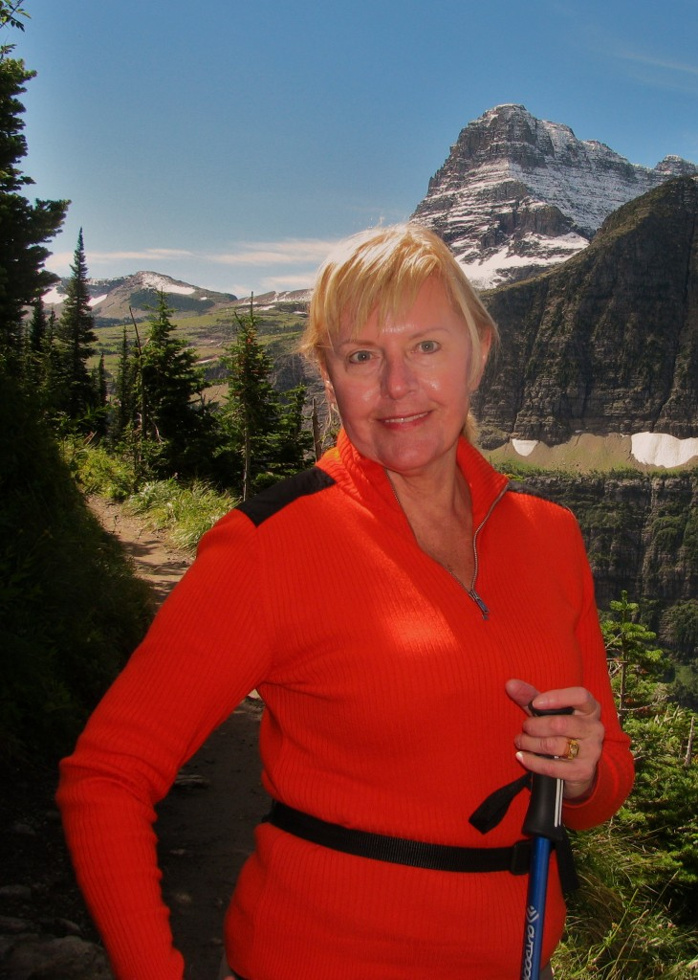
One of these artists, Estelle Condra, is a co-founder of VSA Tennessee and continues to serve on the organization’s board of directors. You’ll hear Estelle’s inspiring story at the end of this webinar.

Slide 12
Meanwhile, think about all the artists you know personally. Make a list! You may have taken their classes, talked with them at a gallery or a reception, or networked for programs in your community. What have you learned from them? How have they inspired you?
To further open your mind to various career possibilities, take a look at these lists of professions and mediums in the arts, opening your mind to your opportunities.

Slide 13
Careers in the Performing Arts
Actor
Animal Trainer
Arranger
Artistic Director
Broadcaster
Choral Director
Choreographer
Cinematographer
Circus Performer
Comedian
Composer
Conductor
Costume Designer
Dancer
Director
Filmmaker
Foley Artist (Sound Effects)
Game Show Host
Juggler
Lighting Designer
Magician
Makeup Artist/Designer
Milliner
Musician
Properties Master/Artisan
Puppet Maker
Puppeteer
Scenic Designer
Seamstress
Set Decorator
Singer
Songwriter
Sound Designer
Special Effects Artist
Stage Combat Specialist
Stunt Artist
Voiceover Artist
Wig Master

Slide 14
Many of these occupations require assistants. Some depend on a wide variety of engineers, technicians, and specialists.
Related jobs in the performing arts include stage managers, company managers, carpenters, instrument-makers, instrument and props repair specialists, dramaturges, teachers, coaches, physical therapists, attorneys, booking agents, talent buyers, casting directors, administrators, customer service providers (including ticket-sellers, ushers and visitor information staff), American Sign Language interpreters and audio describers, who narrate performance action for audience members with visual impairments.

Slide 15
Mediums in the visual Arts
Animation
Architectural Renderings and Models
Calligraphy
Cartography
Cartoons
Ceramics
Courtroom Sketching
Designing Displays and Exhibits
Drafting
Drawing
Engraving
Etching
Fashion Design
Fashion Illustrator
Fiber Arts
Floral Designer
Furniture Designer
Glass Blower
Graphic Designer
Greeting Card Artist
Illustration
Interior Design
Jewelry
Lettering
Lithography
Medical Illustrator
Metals
Multimedia
Murals
Painting
Photography
Pottery
Printmaker
Printmaking
Quick Sketch
Scientific Illustration
Sculpture
Sign Making
Silhouette
Silkscreen
Stained Glass
Stencil
Toy Design
Toy-making
Wood

Slide 16
As it is in the performing arts, many of the occupations in these mediums require assistants, technicians and specialists. Related jobs in the visual arts include gallery operators, curators, art historians, art therapists, managers, teachers, administrators, program managers, customer service providers, and support staff.

Slide 17
Be it the visual or the performing artists, many artists find great fulfillment in working for organizations like community arts councils, museums, performance venues, educational institutions, and producing organizations (i.e. theatre, opera, ballet, symphony).

Slide 18
As you already know, for every performer you see on a stage and for every artist who exhibits in a museum, dozens of individuals are working behind the scenes, on the frontline, and in the administrative offices. These employees are generally men and women who share a passion for the arts and want to advance artistic opportunities in their schools and communities. They raise funds and manage advertising, publicity, community outreach, and audience development. They create and implement education programs to serve local children.

Slide 19
They work in accounting, human resources, and information technology. They coordinate the service of volunteers, give tours, and greet visitors.
As you pursue possibilities for yourself, explore the potential for a career with an arts organization, school, or management company. You may find yourself in a place with an artistic mission, surrounded by artists and innovative people who care about the arts. Look for opportunities to apply your talents, skills and interests in creative ways.

Slide 20
Putting Creativity to Work: Careers in the Arts for People with Disabilities
VSA arts (the national organization) published an excellent online publication that you can download in PDF format: “Putting Creativity to Work: Careers in the Arts for People with Disabilities”
You can follow this link: http://www.kennedy-center.org/education/vsa/resources/creativity_work.cfm or go to www.kennedy-center.org and search for “Putting Creativity to Work,” then clicking on first title at the very top of the search results.

Slide 21
Published by VSA in 2000, this is an extraordinary, thorough publication that remains highly relevant. It’s extremely well written, interesting and engaging. The assessment tools are especially helpful, posing critical questions you need to ask yourself.
“Putting Creativity to Work” also features inspiring stories about artists with disabilities. Anyone who is serious about a career in the arts will want to take the time for self-evaluation with the assessment tools in the first chapter and to read through the entire publication.

Slide 22
Meet Estelle Condra
Tennessee has its own remarkable story about a highly successful artist who is blind.

Slide 23
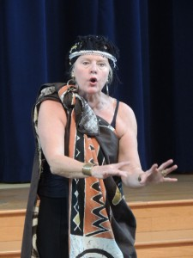
Estelle Condra has had a diverse and distinguished career in theatre arts from her native South Africa, to the United States.
Blind due to the hereditary disease Retinitis Pigmentosa, she has woven the threads of gradually losing her sight into her artistic expressions.
She is a founding member of VSA Tennessee, continues to serve on its board of directors, and is the recipient of its highest honor from the organization dedicated to serving people with disabilities to participate in and express themselves through the arts.

Slide 24
Estelle enhanced her acting career with teaching, writing, speaking, and operating speech and drama schools in both South Africa and Tennessee, where she has lived for more than 30 years. She also published the award-winning children’s book See the Ocean, in its fifth printing.

Slide 25
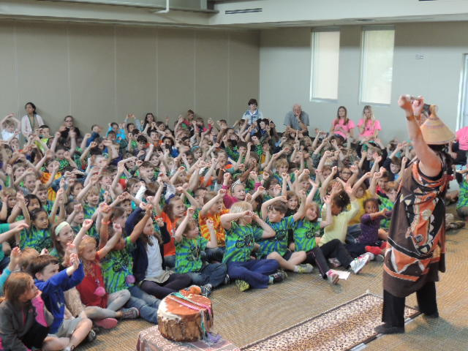
After marrying and moving to Nashville in 1973 Estelle translated and adapted numerous African folk stories for the stage. (Her native language is Afrikaner.)
She became a member of Actors’ Equity Association, the national union of professional actors, performing with the Nashville Children’s Theatre and with Tennessee Repertory Theatre.
As her sight deteriorated to total blindness—what Estelle calls “gaining blindness”—she moved to solo theatre pieces and speeches, which she has been presented nationwide as a sought-after keynote performer and speaker.

Slide 26
What were your early artistic influences and inspirations?
Estelle: I was born in South Africa and lived there all my life until my husband, an American, found me there and I came to the States as his wife.
I grew up in a small, little town. We had no television, but we had radio and sometime travelling theatre groups would come to our town and put on a performance. So I heard this magnificent drama on the radio and I sat in the very front row to see those performances.

Slide 27
Furthermore, the South African people as a whole are storytellers—my aunts, uncles, father and mostly my mother created these worlds of imagination in my mind with their stories. All of that was so influential early in my life.
My mother saw a creativity in me early on. I took ballet, I took piano, and, most important, I took what they called elocution in those years. I took part in competitions and won an award for playing Little Red Riding Hood in the second grade. I was encouraged by that. When you win something that early in life, it makes you happy and you want to do more of that. With accolades and encouragement, before you know it, you’re on the road to becoming a dramatist.

Slide 28
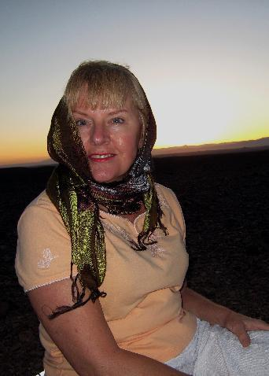
What inspires you?
Estelle: Being that I don’t see, so many things are inspirational to me—the textures that I touch, like the bark of the trees, the sound of the wind across the plain, recordings of opera, sound coming from a distance, like a train whistle.
Sounds from a distance, especially, just rip out images in my mind. I see my mind like a pomegranate. All of a sudden, something just breaks it, something as simple as a train whistle or the sound of an owl.
That alone is enough to break open the pomegranate in my head and all these seeds come spilling out. It inspires me to write something or to imagine a picture. My mind is always moving, like a live movie on a daily basis.

Slide 29
If you see Estelle speaking or performing, or join her at a business meeting of the VSA Tennessee Board of Directors, you quickly realize that she has a great sense of humor. Why is humor so important to you?

Slide 30
Estelle: A sense of humor is an important issue in the life of a disabled person because, I think, you learn that laughter takes you out of yourself and makes you look at yourself in a different way.
One of my performances, Blind People Shouldn’t Vacuum, is a comedy. I’m laughing at myself and others laugh with me when they see it. To ridicule means to expose something to laughter. If you expose your disability to laughter it is like exposing a plant or a seed to light and that plant grows and flourishes.

Slide 31
Laughter makes you strong. It gives you the confidence that you need as an individual with a disability. In fact, “Living in the Light of Laughter” is the title of one of my speeches. If you have any disability—say your hands shake and you’re afraid to take a cup of tea for fear that you’ll spill it—don’t be afraid. Go for it. You might spill and if it happens, break up and laugh.
If people see how you handle the situation and see that you are comfortable, they too are going to be comfortable. So often, others don’t know how to handle people with disabilities and a sense of humor helps them to be more comfortable. That has helped me through all of my life. Even in a business meeting, I’ve never come across a situation where you cannot have a little laughter or evoke a little laughter. Life is hard enough. Laughter gets you through it. Humor gives you a different dimension and perspective. Don’t sweat the small stuff.

Slide 32
You appear to enjoy athletic pursuits like skiing, hiking and horseback riding, along with knitting, ballroom dancing, reading and much more in addition to your work as an artist.
Do you have advice for aspiring artists on how to create balance in their lives, on how to just enjoy life outside of their artistic pursuits?

Slide 33
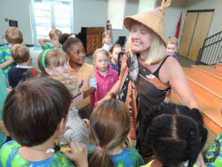
That I think is one of the hard questions. How do you maintain balance in your life as an artist? Whether you are painting, making a pot, or writing a play you can go for hours and not be aware of how much time has passed.
You are in what I call “the flow,” your own wonderful creative place, like a dream state. You have to make yourself break away from that. What I try to do is to set a time when I will go outside, maybe to water the plants.

Slide 34
I also believe it’s important to communicate with people, to spend time with others, with friends, because that strengthens what you have been doing. You have to do something away from your smart phone - something that is more inspiring, more stimulating and more thought-provoking. You absolutely have to make yourself take time to spend with other people. It’s a discipline, important to balance in your life.

Slide 35
You impart valuable, universal lessons in your stories, performances, speeches and your book See The Ocean. Why are the meaning and messages of your stories important to you?

Slide 36
Estelle: Actually, I never think about imparting a lesson. I suppose, first of all, it’s a lesson for myself, a lesson for my soul and my heart. It just happens.
In one of my plays, Vibrations of Laughter, I play four different characters. I start as an 80-year-old woman and end up at the Keller home as Annie Sullivan. Helen was totally blind and deaf and could not talk, but I believe that Annie would have realized that laughter is important in a deaf-blind person’s life. In the end, she taught Helen to laugh.

Slide 37
When I still had some sight I worked in acting companies, Nashville Children’s Theatre and Tennessee Repertory Theatre. I played Annie Sullivan in The Miracle Worker at NCT and went very deep into that remarkable woman.

Slide 38
My first solo drama was Caged. As it opens, I have come into a cage as a disabled person and at the end of the play, I embrace my blindness and come out of the cage, to live fully as a person outside the cage, like a bird would be free. An uncaged bird. That’s what I am. I do have to note that I have a very happy marriage. I’m naturally a happy person. I’m fortunate and lucky. There are not enough words in the English language to describe how blessed I feel on a daily basis

Slide 39
What advice do you have for people, especially young people, who are exploring a career in the arts?

Slide 40
Estelle: First and foremost, if you find that you are good at something, take advantage of every lesson and learning opportunity you can to strengthen that talent. Then, put that talent out there in the world. Sing at your Sunday School or at the library for little children.
Whatever your talent is, put it out there in the world. If you want a career in the arts, that’s a whole different ballgame than just enjoying pottery at the local rec center. Take every chance at strengthening your talent. As my drama teacher used to say ‘you have to be responsible for your talent.’

Slide 41
See www.estellecondra.com for more inspiration!

Slide 42
http://iren.es/artsexp2
Please fill out the brief questionnaire by clicking the link below or paste the url in your browser!

